Slide 1
Chapter 18
Electrochemistry

Slide 2
18.1 Balancing Oxidation–Reduction Equations
18.2 Galvanic Cells
18.3 Standard Reduction Potentials
18.4 Cell Potential, Electrical Work, and Free Energy
18.6 Batteries
18.7 Corrosion
18.8 Electrolysis
18.9 Commercial Electrolytic Processes

Slide 3
Electron Transfer Reactions
Electron transfer reactions are oxidation-reduction or redox reactions.
Results in the generation of an electric current (electricity) or be caused by imposing an electric current.
Therefore, this field of chemistry is often called ELECTROCHEMISTRY.

Slide 4
Electrochemical processes are oxidation-reduction reactions in which:
the energy released by a spontaneous reaction is converted to electricity or
electrical energy is used to cause a nonspontaneous reaction to occur
0
0
2+
2-
2Mg (s) + O₂ (g) 2MgO (s)
2Mg 2Mg2+ + 4e-
Oxidation half-reaction (lose e-)
O₂ + 4e- 2O2-
Reduction half-reaction (gain e-)
19.1

Slide 5
Terminology for Redox Reactions
OXIDATION—loss of electron(s) by a species; increase in oxidation number; increase in oxygen.
REDUCTION—gain of electron(s); decrease in oxidation number; decrease in oxygen; increase in hydrogen.

Slide 6
Half–Reactions
The overall reaction is split into two half–reactions, one involving oxidation and one reduction.
8H⁺ + MnO₄⁻ + 5Fe²⁺ → Mn²⁺ + 5Fe³⁺ + 4H₂O
Reduction: 8H⁺ + MnO₄⁻ + 5e⁻ → Mn²⁺ + 4H₂O
Oxidation: 5Fe²⁺ → 5Fe³⁺ + 5e⁻

Slide 7
The Half–Reaction Method for Balancing Equations for Oxidation–Reduction Reactions
Write separate equations for the oxidation and reduction half–reactions.
For each half–reaction:
Balance all the elements except H and O.
Balance O using H₂O.
Balance H using H⁺.
Balance the charge using electrons.

Slide 8
The Half–Reaction Method for Balancing Equations for Oxidation–Reduction Reactions
If necessary, multiply one or both balanced half–reactions by an integer to cancel out the electrons.
Add the half–reactions, and cancel identical species.
Check that the elements and charges are balanced.

Slide 9
Cr₂O₇²⁻(aq) + SO₃²⁻(aq) → Cr³⁺(aq) + SO₄²⁻(aq)
How can we balance this equation?
First Steps:
Separate into half-reactions.
Balance elements except H and O.

Slide 10
Method of Half Reactions
Cr₂O₇²⁻(aq) → Cr³⁺(aq)
SO₃²⁻(aq) → SO₄²⁻(aq)
Now, balance all elements except O and H.

Slide 11
Method of Half Reactions (continued)
Cr₂O₇²⁻(aq) → 2Cr³⁺(aq)
SO₃²⁻(aq) → + SO₄²⁻(aq)
How can we balance the oxygen atoms?

Slide 12
Method of Half Reactions (continued)
Cr₂O₇²⁻(aq) → 2Cr³⁺(aq) + 7H₂O
H₂O +SO₃²⁻(aq) → + SO₄²⁻(aq)
How can we balance the hydrogen atoms?

Slide 13
Method of Half Reactions (continued)
This reaction occurs in an acidic solution.
14H⁺ + Cr₂O₇²⁻ → 2Cr³⁺ + 7H₂O
H₂O +SO₃²⁻ → SO₄²⁻ + 2H⁺
How can we write the electrons?

Slide 14
Method of Half Reactions (continued)
This reaction occurs in an acidic solution.
6e⁻ + 14H⁺ + Cr₂O₇²⁻ → 2Cr³⁺ + 7H₂O
H₂O +SO₃²⁻ → SO₄²⁻ + 2H⁺ + 2e⁻
How can we balance the electrons?

Slide 15
Method of Half Reactions (continued)
14H⁺ + 6e⁻ + Cr₂O₇²⁻ → 2Cr³⁺ + 7H₂O
3[H₂O +SO₃²⁻ → SO₄²⁻ + 2e⁻ + 2H⁺]
Final Balanced Equation:
Cr₂O₇²⁻ + 3SO₃²⁻ + 8H⁺ → 2Cr³⁺ + 3SO₄²⁻ + 4H₂O

Slide 16
Exercise
Balance the following oxidation–reduction reaction that occurs in acidic solution.
Br–(aq) + MnO₄–(aq) → Br₂(l)+ Mn²⁺(aq)
10Br–(aq) + 16H⁺(aq) + 2MnO₄–(aq) → 5Br₂(l)+ 2Mn²⁺(aq) + 8H₂O(l)
Notes:
10Br⁻(aq) + 16H⁺(aq) + 2MnO₄⁻(aq) → 5Br₂(l)+ 2Mn²⁺(aq) + 8H₂O(l)

Slide 17
Exercise
Balance the following oxidation–reduction reaction.
K₂Cr₂O₇ + SnCl₂ + HCl → CrCl₃ + SnCl₄ + KCl + H₂O
K₂Cr₂O₇ + H₂O + S → SO₂ + KOH + Cr₂O₃

Slide 18
The Half–Reaction Method for Balancing Equations for Oxidation–Reduction Reactions Occurring in Basic Solution
Use the half–reaction method as specified for acidic solutions to obtain the final balanced equation as if H⁺ ions were present.
To both sides of the equation, add a number of OH– ions that is equal to the number of H⁺ ions. (We want to eliminate H⁺ by forming H₂O.)

Slide 19
The Half–Reaction Method for Balancing Equations for Oxidation–Reduction Reactions Occurring in Basic Solution
Form H₂O on the side containing both H⁺ and OH– ions, and eliminate the number of H₂O molecules that appear on both sides of the equation.
Check that elements and charges are balanced.

Slide 20
Practice
Cr(OH)₃ + ClO₃⁻ --> CrO₄²⁻ + Cl⁻ (basic)

Slide 21
Galvanic Cell
Device in which chemical energy is changed to electrical energy.
Uses a spontaneous redox reaction to produce a current that can be used to do work.

Slide 22
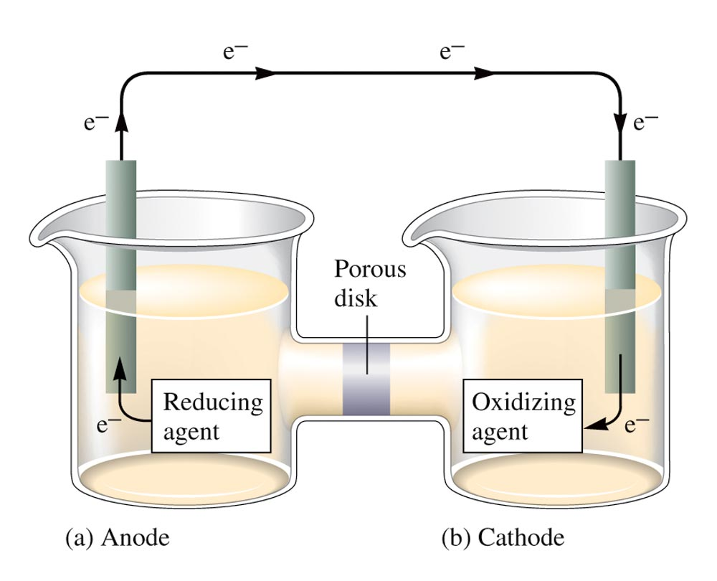
A Galvanic Cell

Slide 23
Galvanic Cell
Oxidation occurs at the anode.
Reduction occurs at the cathode.
Salt bridge or porous disk – devices that allow ions to flow without extensive mixing of the solutions.
Salt bridge – contains a strong electrolyte held in a Jello–like matrix.
Porous disk – contains tiny passages that allow hindered flow of ions.

Slide 24
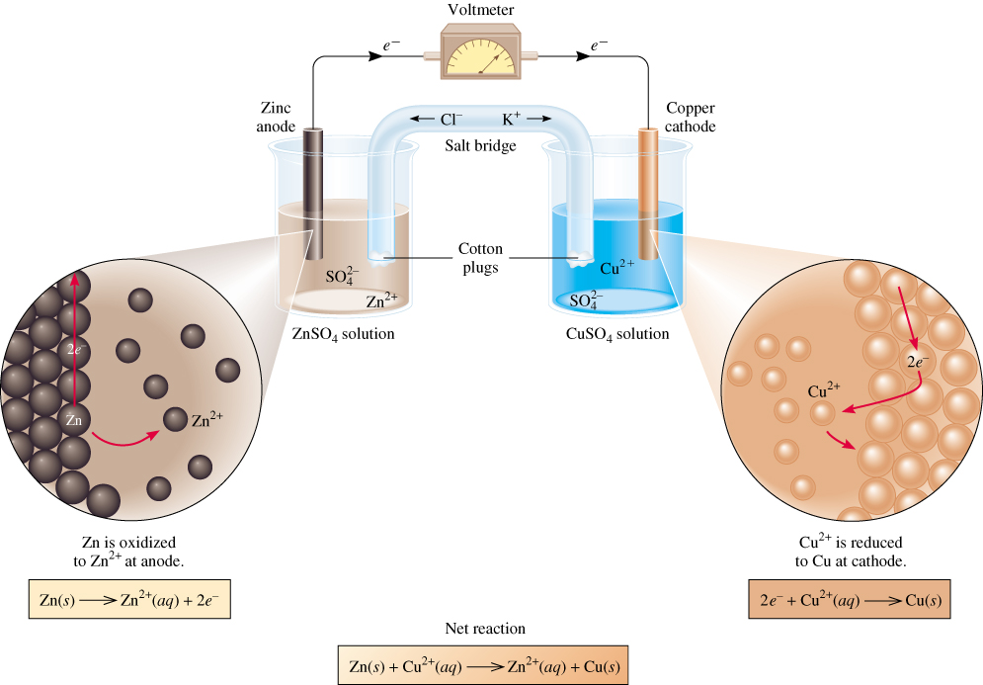
Galvanic Cells
anode
oxidation
cathode
reduction
-
+
spontaneous
redox reaction
19.2

Slide 25
http://www.mhhe.com/physsci/chemistry/essentialchemistry/flash/galvan5.swf
http://glencoe.mheducation.com/sites/0003152012/student_view0/chapter18/animations.html#

Slide 26
Cell Potential
A galvanic cell consists of an oxidizing agent in one compartment that pulls electrons through a wire from a reducing agent in the other compartment.
The “pull”, or driving force, on the electrons is called the cell potential ( ), or the electromotive force (emf) of the cell.
Unit of electrical potential is the volt (V).
1 joule of work per coulomb of charge transferred. (Joule = coulomb x volt)
1 ampere = 1 coulomb per second
1 mole of e- = 96,485 coulombs

Slide 27
Galvanic Cell
All half-reactions are given as reduction processes in standard tables.
Table 18.1
1 M, 1 atm, 25°C
When a half-reaction is reversed, the sign of E ° is reversed.
When a half-reaction is multiplied by an integer, E ° remains the same.
A galvanic cell runs spontaneously in the direction that gives a positive value for E °_{cell}.

Slide 28
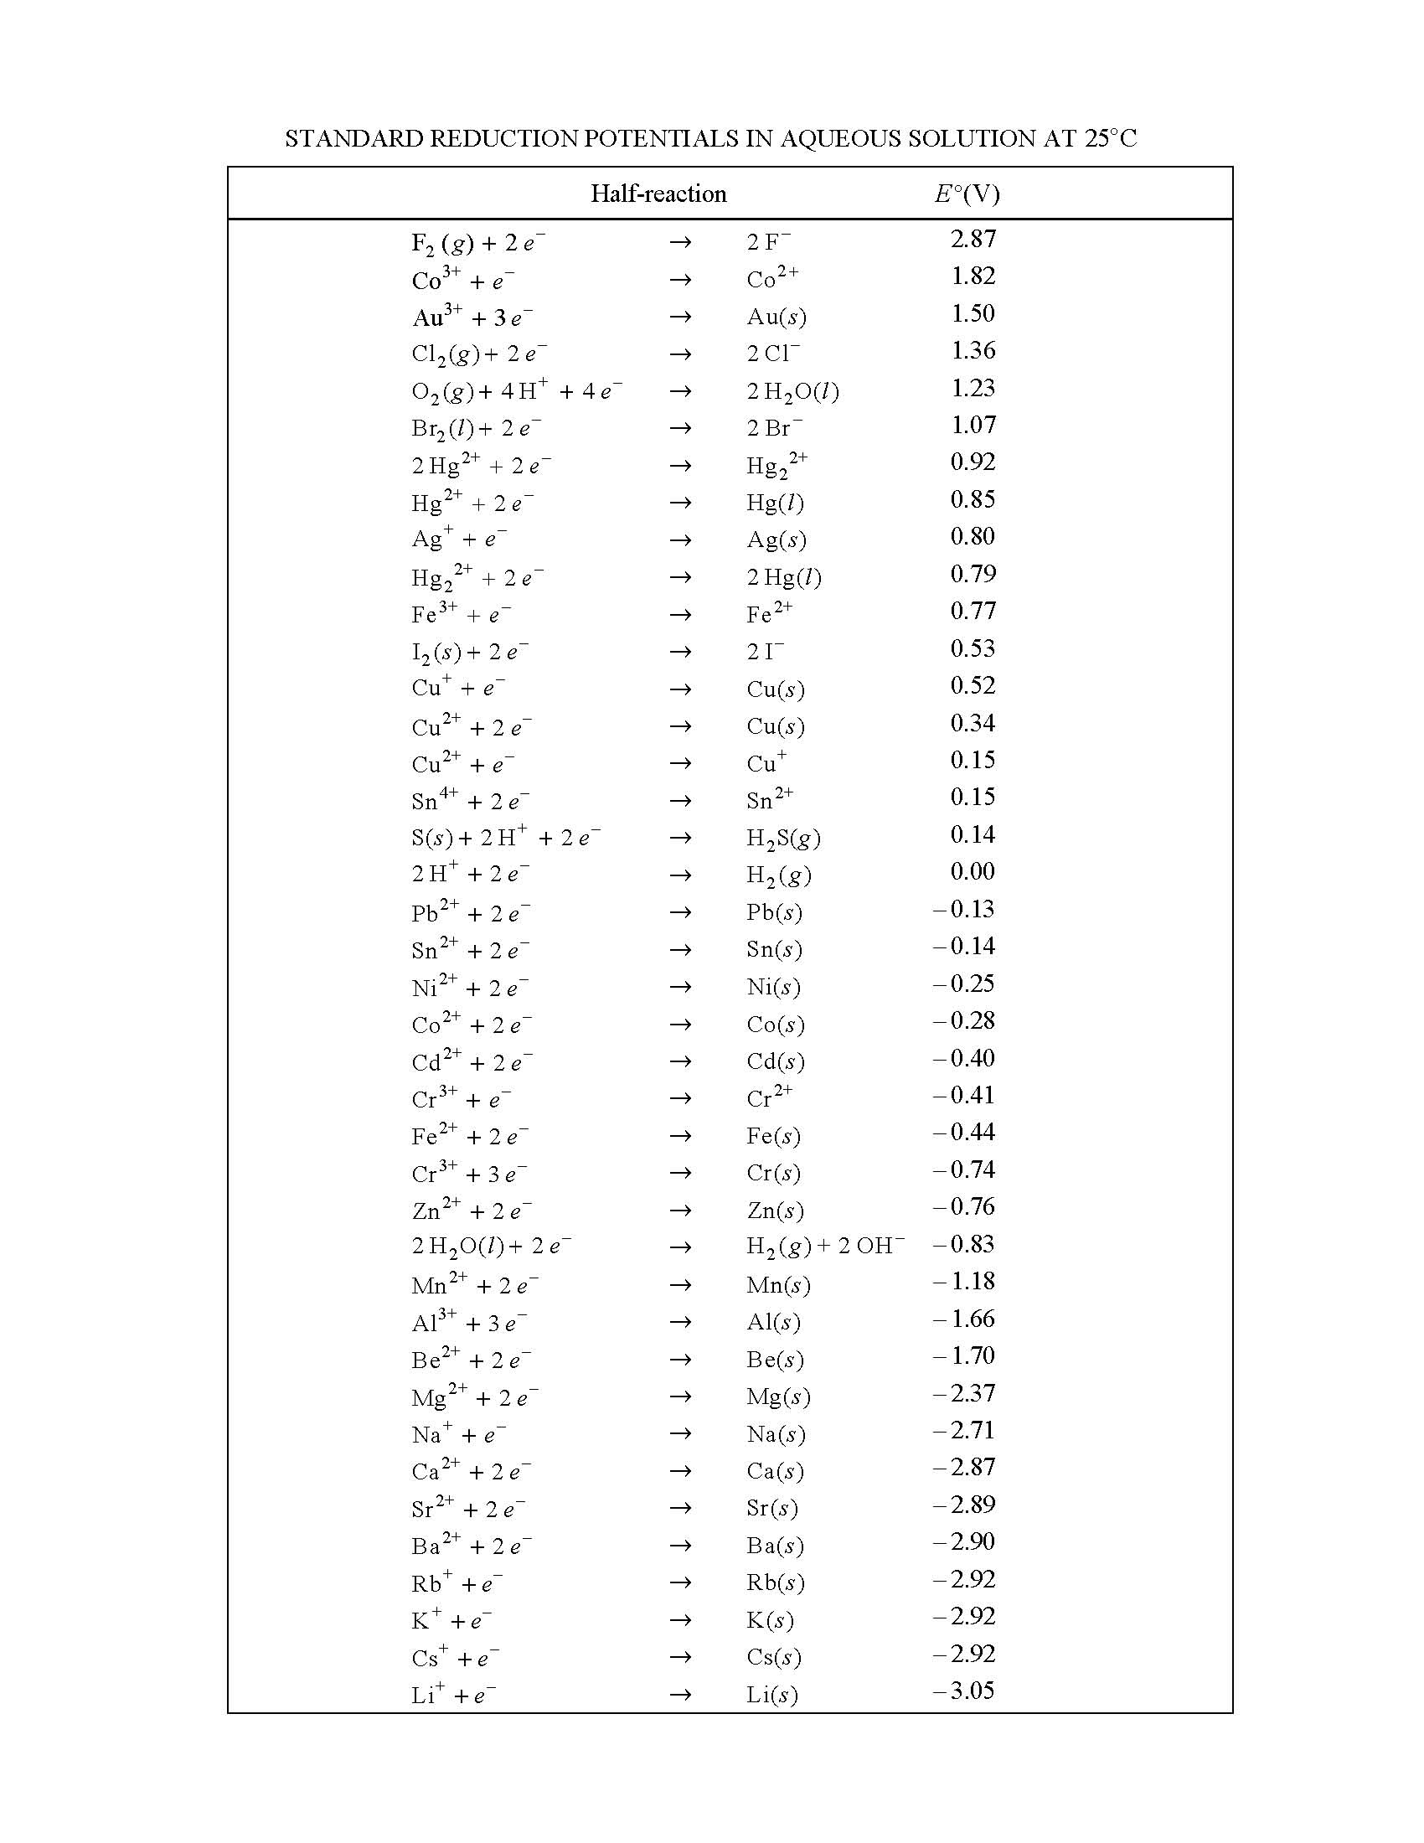
OLD Official AP
Reduction Table
Copyright
College Board
These values are now provided within each problem when needed

Slide 29
Example: Fe³⁺(aq) + Cu(s) → Cu²⁺(aq) + Fe²⁺(aq)
Half-Reactions:
Fe³⁺ + e– → Fe²⁺ E ° = 0.77 V
Cu²⁺ + 2e– → Cu E ° = 0.34 V
To calculate the cell potential, we must reverse reaction 2.
Cu → Cu²⁺ + 2e– – E ° = – 0.34 V

Slide 30
Overall Balanced Cell Reaction
2Fe³⁺ + 2e– → 2Fe²⁺ E ° = 0.77 V (cathode)
Cu → Cu²⁺ + 2e– – E ° = – 0.34 V (anode)
Cell Potential:
E °_{cell} = E °(cathode) – E °(anode)
**not on formula sheet! *** the – in the equation automatically flips the anode
E °_{cell} = 0.77 V – 0.34 V = 0.43 V

Slide 31
Charging a Battery
When you charge a battery, you are forcing the electrons backwards (from the + to the -). To do this, you will need a higher voltage backwards than forwards. This is why the ammeter in your car often goes slightly higher while your battery is charging, and then returns to normal.
In your car, the battery charger is called an alternator. If you have a dead battery, it could be the battery needs to be replaced OR the alternator is not charging the battery properly.

Slide 32
Line Notation
Used to describe electrochemical cells.
Anode components are listed on the left.
Cathode components are listed on the right.
Separated by double vertical lines.
The concentration of aqueous solutions should be specified in the notation when known.
Example: Mg(s)|Mg²⁺(aq)||Al³⁺(aq)|Al(s)
Mg → Mg²⁺ + 2e– (anode)
Al³⁺ + 3e– → Al (cathode)

Slide 33
Work
Work is never the maximum possible if any current is flowing.
In any real, spontaneous process some energy is always wasted – the actual work realized is always less than the calculated maximum.

Slide 34
Maximum Cell Potential
Directly related to the free energy difference between the reactants and the products in the cell.
ΔG° = –nFE ° **on formula sheet
F = 96,485 C/mol e–

Slide 35
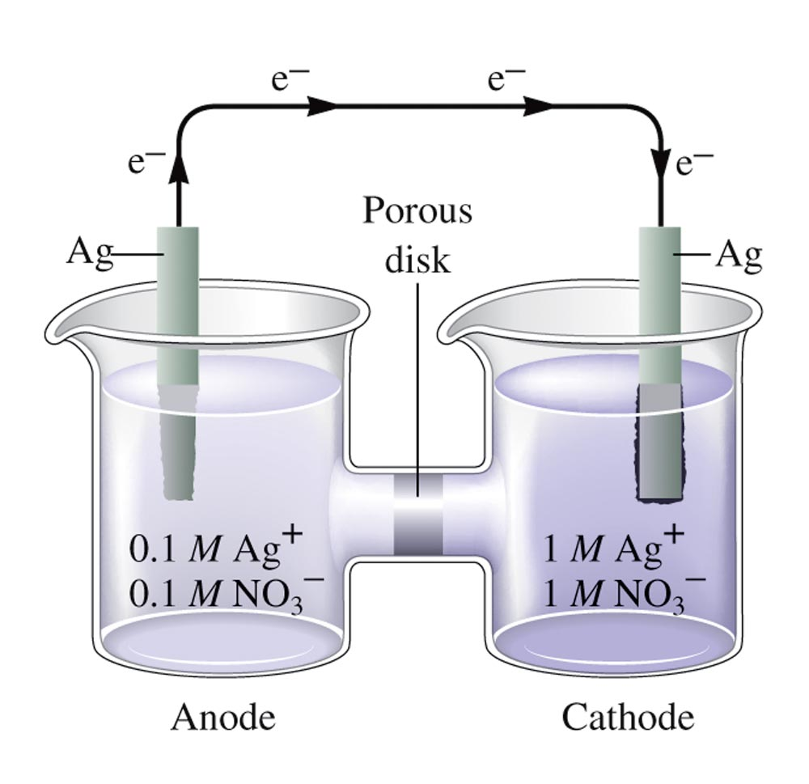
A Concentration Cell

Slide 36
Nernst Equation
At 25°C: n = number of moles of e-
or
(at equilibrium)
**NOT on formula sheet

Slide 37
Nernst Equation
At ANY temp: n = number of moles of e-
** on formula sheet

Slide 38
Concept Check
Explain the difference between E and E °.
When is E equal to zero?
When the cell is in equilibrium ("dead" battery).
Notes:
ε is the cell potential at any condition, and ε° is the cell potential under standard conditions (1.0 M or 1 atm, and 25°C).
ε equals zero when the cell is in equilibrium ("dead" battery). ε° is equal to zero for a concentration cell.

Slide 39
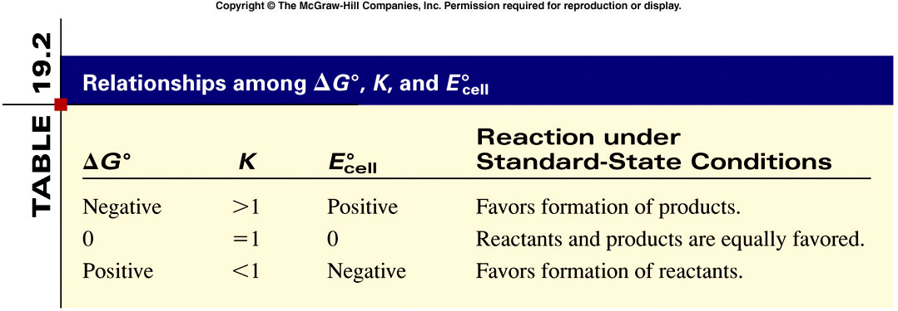
Spontaneity of Redox Reactions
19.4

Slide 40
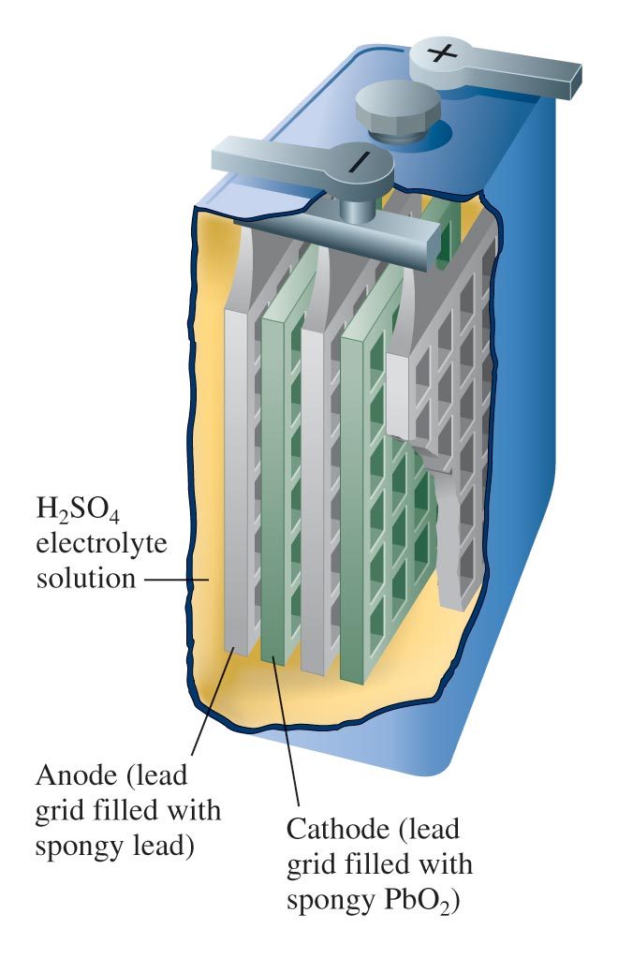
One of the Six Cells in a 12–V Lead Storage Battery

Slide 41
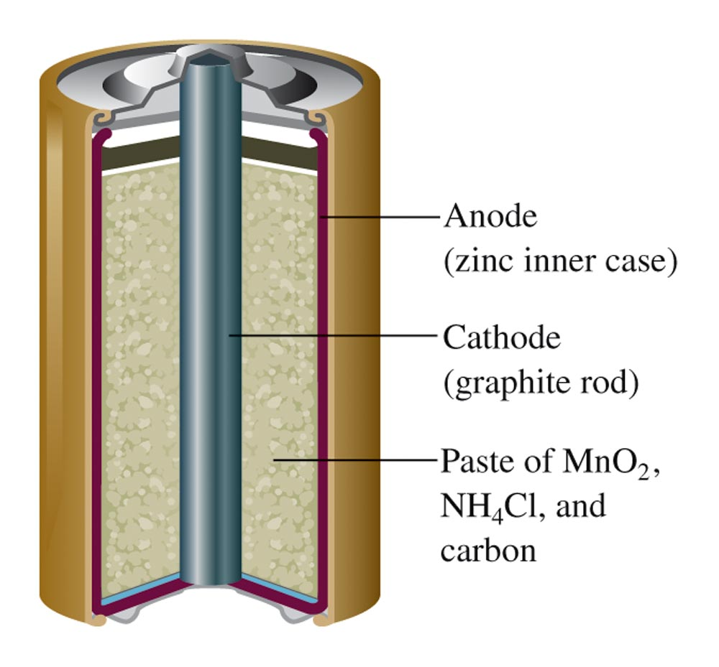
A Common Dry Cell Battery

Slide 42
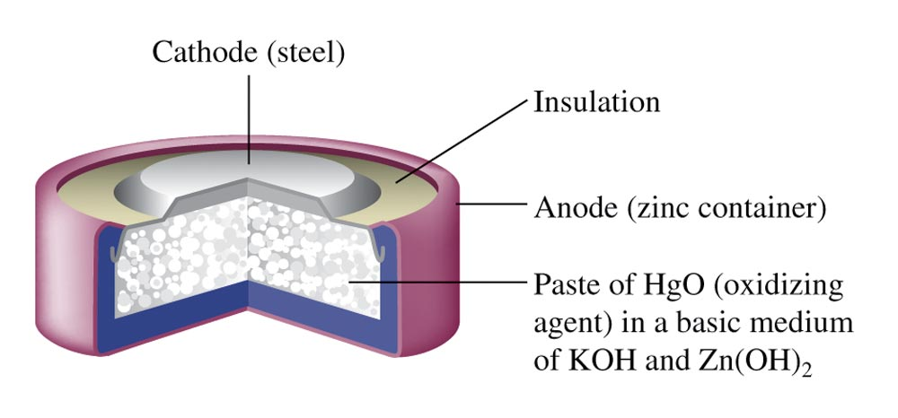
A Mercury Battery

Slide 43
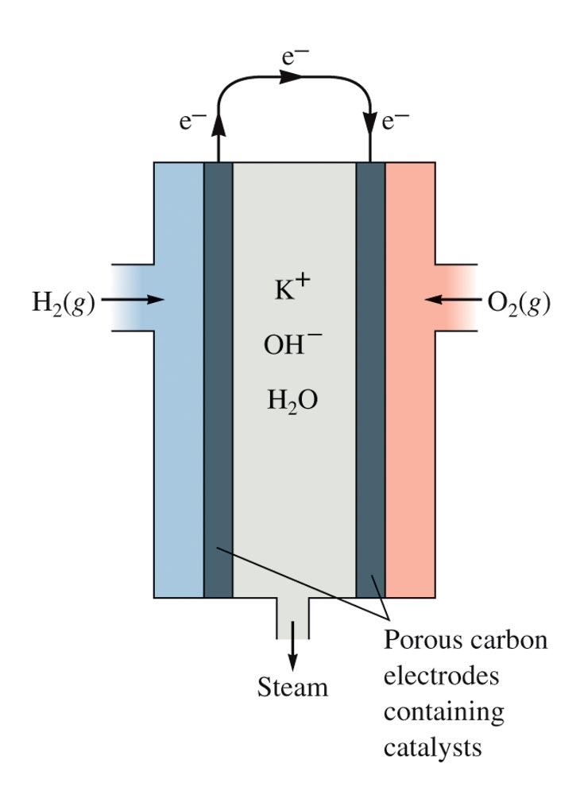
Schematic of the Hydrogen-Oxygen Fuel Cell

Slide 44
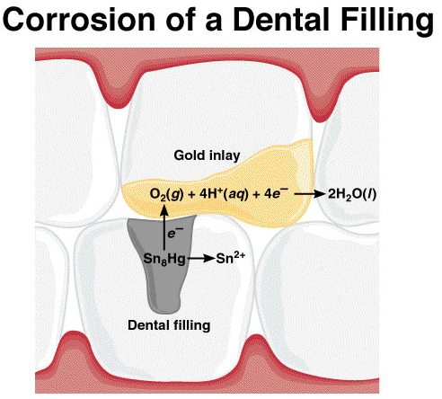
Chemistry In Action: Dental Filling Discomfort
2+
Hg₂ /Ag₂Hg₃ 0.85 V
2+
Sn /Ag₃Sn -0.05 V
2+
Sn /Ag₃Sn -0.05 V

Slide 45
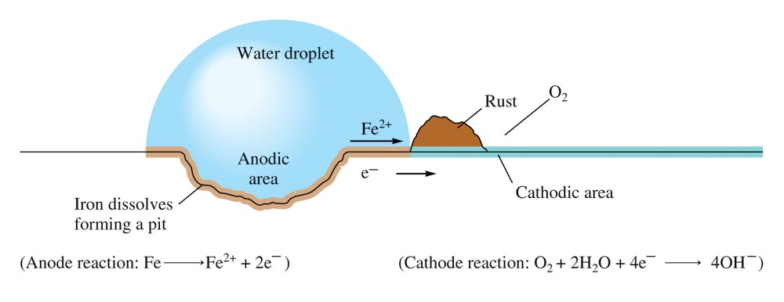
The Electrochemical Corrosion of Iron

Slide 46
Process of returning metals to their natural state – the ores from which they were originally obtained.
Involves oxidation of the metal.

Slide 47
Corrosion Prevention
Application of a coating (like paint or metal plating)
Galvanizing
Alloying
Cathodic Protection
Protects steel in buried fuel tanks and pipelines.

Slide 48
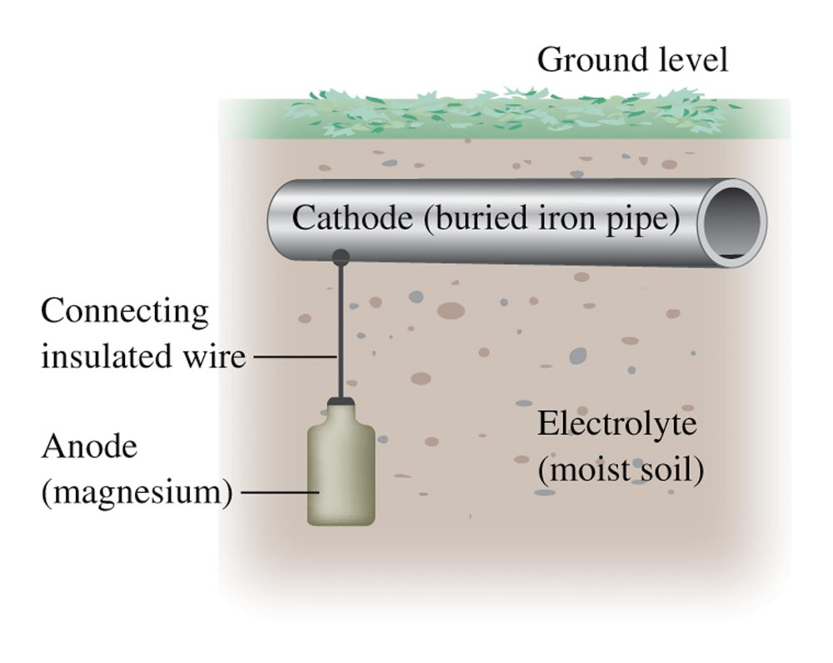
Cathodic Protection

Slide 49
Forcing a current through a cell to produce a chemical change for which the cell potential is negative.

Slide 50
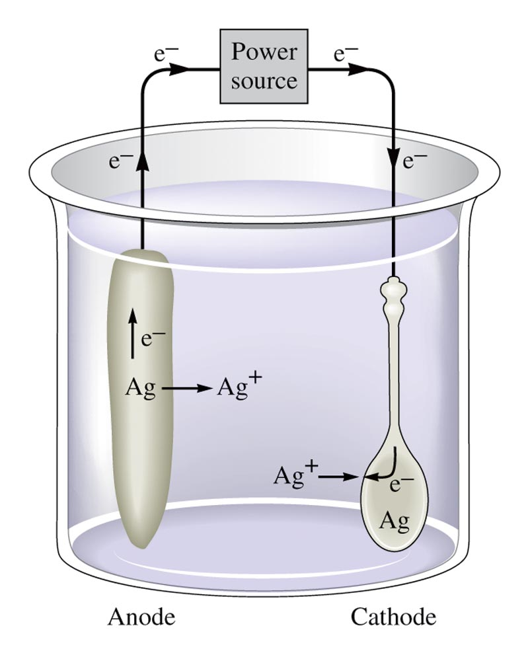
Electroplating a Spoon

Slide 51
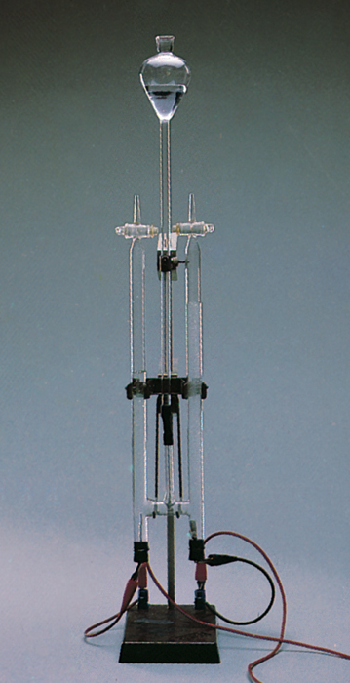
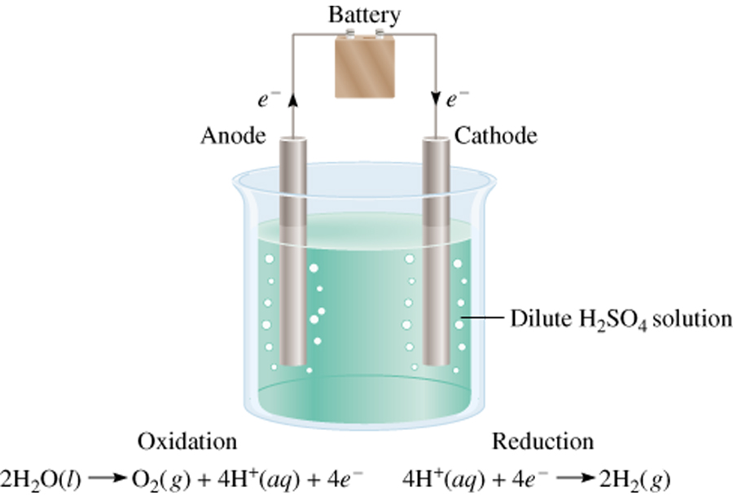
Electrolysis of Water
19.8

Slide 52
Stoichiometry of Electrolysis
How much chemical change occurs with the flow of a given current for a specified time?
current and time → quantity of charge →
moles of electrons → moles of analyte →
grams of analyte

Slide 53
Stoichiometry of Electrolysis
current and time → quantity of charge
1 ampere = 1 coulomb per second
1 mole of e- = 96,485 coulombs
Coulombs of charge = amps (C/s) × seconds (s)
quantity of charge → moles of electrons

Slide 54
How much Ca will be produced in an electrolytic cell of molten CaCl₂ if a current of 0.452 A is passed through the cell for 1.5 hours?
Anode:
2Cl- (l) Cl₂ (g) + 2e-
Cathode:
Ca2+ (l) + 2e- Ca (s)
Ca2+ (l) + 2Cl- (l) Ca (s) + Cl₂ (g)
2 mole e- = 1 mole Ca
C
s
1 mol e-
1 mol Ca
mol Ca = 0.452
x 1.5 hr x 3600
x
x
s
hr
96,500 C
2 mol e-
= 0.0126 mol Ca
= 0.50 g Ca
19.8

